Slide 1
Year 10 Parents’ Information Evening
Study & Revision Skills - Mrs Kruczyk
English – Mr. Dunham
Maths – Mr. Roman
Science – Miss Haria
Well-Being - Mrs Kruczyk
Supporting your child during the exam preparation

Slide 2
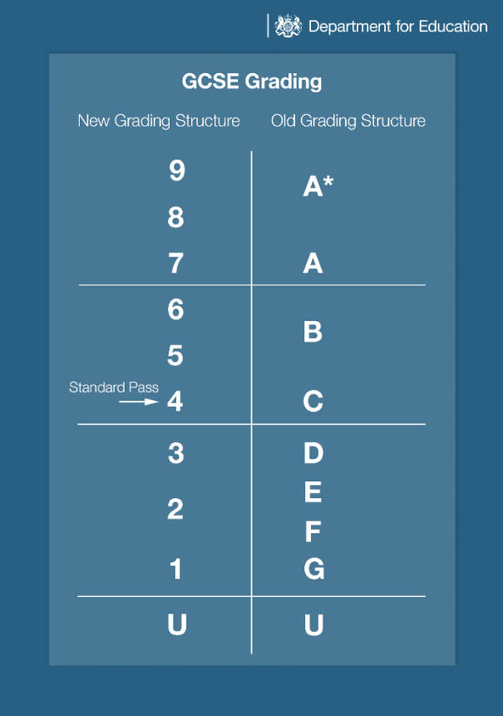

Slide 4
Important dates
Starting June 19th, 2023
Mock examinations
December 2023
Mock examinations
March 2024
Final Mock examinations in core subjects
Starting May 2024
GCSE examinations

Slide 5
How do I revise?

Slide 6
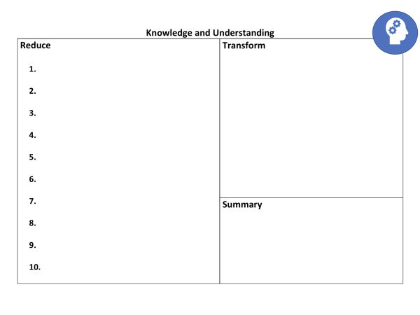
Thinking hard
This is all about taking loads of information and making it manageable
Start with your notes
Transform them into 10 pictures
Reduce each topic into 10 bullet points
Summarise the topic

Slide 7
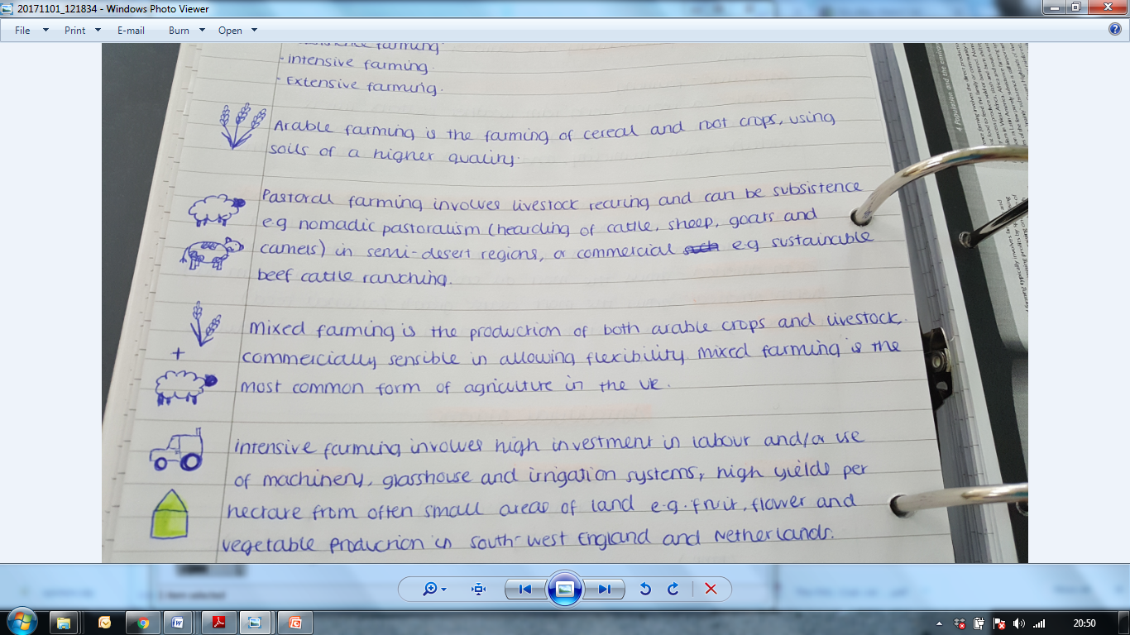

Slide 8
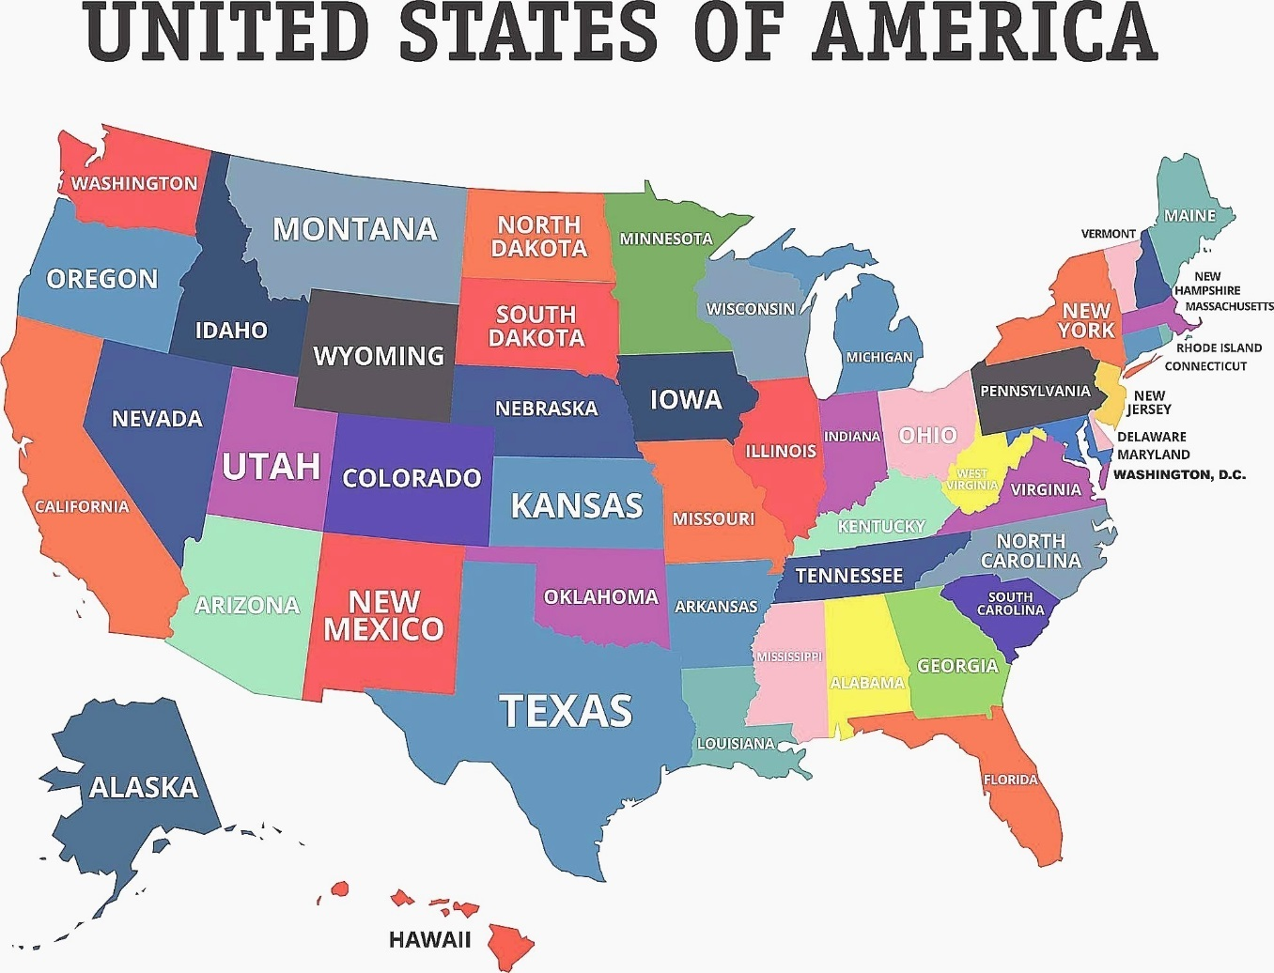
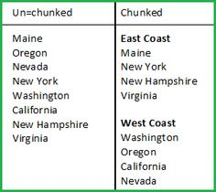
chunking
It’s about grouping information, so instead of remembering a long list of things, you have to remember a few groups of things.

Slide 9
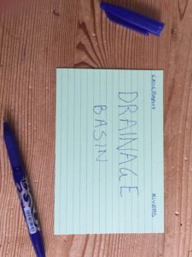
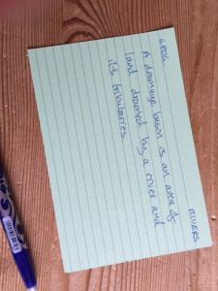
Flash cards
You should only have small amounts of information on the flash cards
One key word or question on one side
The answer on the other side
Then you can use them to easily test yourself

Slide 10
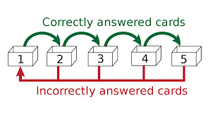
Leitner system

Slide 11
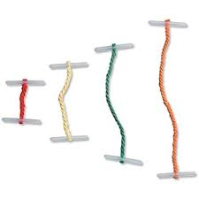
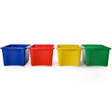
Leitner system

Slide 12
Revision timetable
Here you write the topics that you are going to revise that day.
Once you finish your revision you say how it all went.
Then you write which bits you are going to recap and where you can find them.

Slide 13
Exam questions

Slide 14
Don’t break the chain

Slide 15
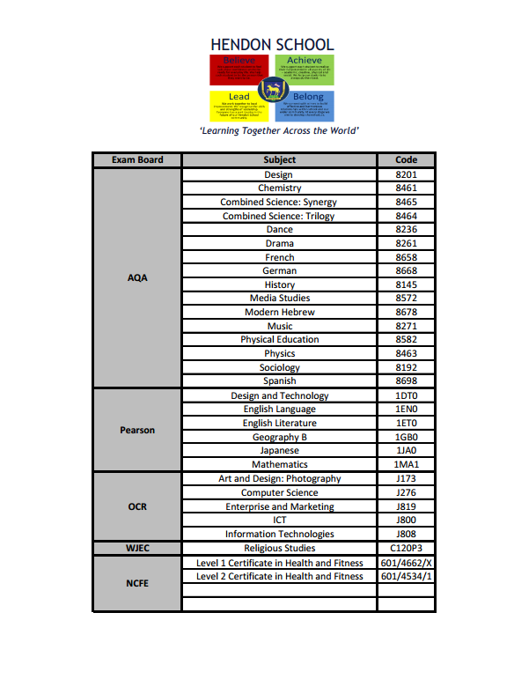

Slide 17
GCSE English Language
Two examinations to be sat in Summer 2024;
Component 1: Fiction and Imaginative Writing (40%);
Component 2: Non-fiction and Transactional Writing (60%).
Encourage reading of Heritage Fiction – the classics, such as Charles Dickens, the Brontë sisters, Jane Austen, Edgar Allen Poe.
What can I do to help?
Get your child to read the newspaper!
(The Guardian, The Times, The Telegraph, The Independent… available in print or online.)
Access to a dictionary and thesaurus – hard copy or online.

Slide 18
GCSE English Literature
Two examinations to be sat in Summer 2024;
Component 1: Shakespeare and Post-1914 Literature (50%);
Component 2: 19th-century Novel and Poetry since 1789 (50%).
Useful historical research:
Renaissance Italy, the
Elizabethan era, the Russian
Revolution, Victorian England.
What can I do to help?
Ensure that your child has a copy of the set texts: Romeo & Juliet by William Shakespeare; A Christmas Carol by Charles Dickens; Animal Farm by George Orwell.

Slide 20
Recommended books for GCSE Maths

Slide 21
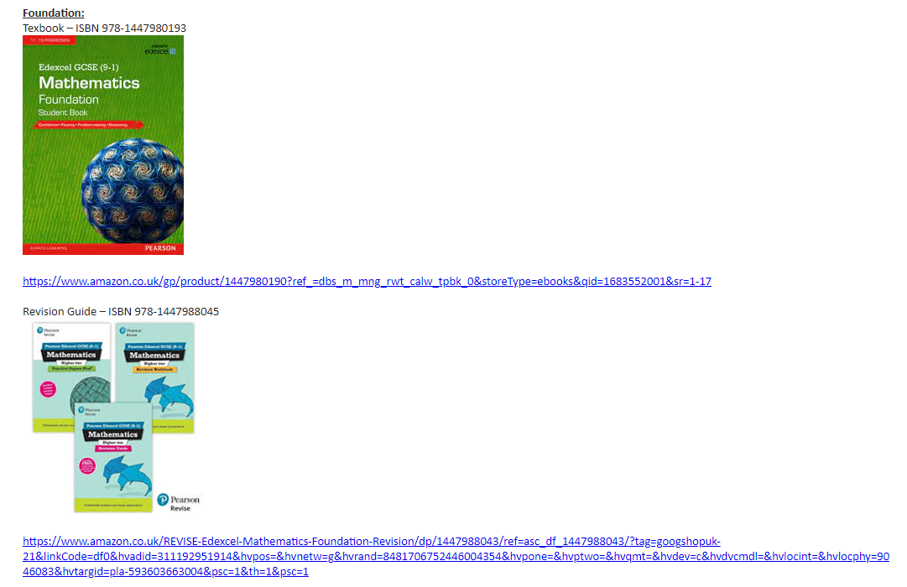
Recommended books for GCSE Maths

Slide 23
GCSE Combined Science
Six examinations to be sat in Summer 2024, 2 GCSEs awarded;
Each paper is worth 16.7% of the overall GCSE and will include multiple choice, structured, closed short answer, and open response questions.
Purchase the CGP workbook photographed below
What can I do to help?
Encourage your child to use the CGP revision guide to make flash cards for all topics studied

Slide 24
GCSE Separate Science (Triple)
Six examinations to be sat in Summer 2024, 3 GCSEs awarded;
Each paper is worth 50% of the overall GCSE and will include multiple choice, structured, closed short answer, and open response questions.
Purchase the CGP workbook photographed below
What can I do to help?
Encourage your child to use the CGP revision guide to make flash cards for all topics studied

Slide 25
Y10 mocks
3 examinations to be sat covering Paper 1 content for all three sciences;
Biology | Chemistry | Physics
Foundation: pg 11-56 Higher: pg 11-57 Topics: B1 – cells B2 – tissues and organs B3 – communicable disease B4 - Bioenergetics | Foundation:pg96-137 Higher: pg96 – 141 Topics: C1 – atomic structure C2 – bonding C3 – quantitative C4 – chemical changes C5 – energy changes | Foundation:pg197-202 Higher: pg 167-200 P1 – energy P2 – electricity P3 – particle model P4 – atomic structure
We will use the mocks to determine
Tiers – foundation or higher
Moves between combined science and separate science
Predicted grades for college and sixth form applications

Slide 27
There are 7 main areas where you can help your child prepare for exams
Be supportive
Routine
Healthy eating
Time out
Keep them active
Unplugging
Sleep patterns
Be supportive

Slide 28
1. Be Supportive
Work with your child to find what revision style works for them,
Ask if there is any way you can help,
Remain positive,
Let them know their feelings are valid and normal, but also offer support and solutions where possible,
Work with them to develop relaxation techniques.

Slide 29
2. Routine
Encourage them to keep their revision planner visible – e.g. printed and displayed on their bedroom wall,
Encourage them to stick to it - Starting early in the day will still leave time to relax later and ensure they feel on top of everything,
Try and provide them with a specific working space – a desk or a table,
If possible, consider the noise, temperature and light - the comfort and tidiness of their surroundings can have an impact on their mood.

Slide 30
3. Healthy Eating
Encourage them to eat breakfast everyday,
Avoid high sugary and fatty foods or drinks,
Give them regular snacks but ideally choose fruit,
Hydration is key to brain functioning so make sure your child drinks plenty of water

Slide 31
4. Time out
- Encourage them to build in opportunities to take some time out every week, away from study. For example:
Seeing friends,
Having a bath,
Listening to music,
Reading a book,
Doing a hobby,
Going shopping,
Going to the cinema,

Slide 32
5. Keep them active
Encourage them to keep active on a daily basis,
Plan to do active things together, perhaps on a weekend,
Go out for a walk together and get some fresh air,
Help them plan out their weekly exercise schedule in advance,
After exercise the brain functions well, so encourage a revision session afterwards.

Slide 33
6. Unplugging
Encourage them to unplug from technology everyday,
Make sure they put their phone away while they are revising or doing homework
Help them learn to have the control to not be obsessed with their phone,
Help them switch off from technology at least 30 mins- 1 hr before going to sleep

Slide 34
7. Sleep patterns
Anxiety is often worst at night and this means it is useful to encourage a good bedtime routine. Young people need between 8 – 9 hours sleep per night.
Help your child create a relaxing evening routine,
Make sure they don’t eat too late at night,
Avoid giving them caffeine or sugary drinks late at night,
Make sure they don’t work or revise too late before going to bed,
Encourage them to switch off from social media / technology at least an hour before bedtime.

Slide 35
Attendance & Punctuality
What chance have you got of achieving in your final exams?
100%
Best chance possible
96%
Should be ok
94%
At risk of under performing
92%
Serious Risk of under performing
90%
Very Serious risk

Slide 36
What does attendance look like?
100%
0 Days
0 Lessons Missed
99%
1 Day
5 Lessons Missed
98%
3 Days
15 Lessons Missed
97%
1 Week
25 Lessons Missed
96%
1.5 Weeks
35 Lessons Missed
94%
2 Weeks
50 Lessons Missed
93%
2.5 Weeks
65 Lessons Missed
92%
3 Weeks
75 Lessons Missed
90%
3.5 Weeks
90 Lessons Missed

Slide 37
8. Be Supportive
Set aside one to one time so that they can talk to you about any worries,
Plan a treat or an activity together to mark the end of the exams,
Help focus them and talk to them about their goals regularly,
Avoid telling them that you know they will do well – instead focus on the message that you want them to do their best,
Reassure them – reinforce that you are and will be proud of them no matter what happens,

