Slide 1
Year 11 Information Evening
03/10/24

Slide 2
Agenda:
Headteacher Welcome
Head of Science Presentation
Head of English Presentation
Head of Maths Presentation
Careers Leader Presentation
Director of KS4 talk
Head of Year talk
Q and A – refreshments in the canteen

Slide 3
Mr McGuire Co-Headteacher

Slide 4
Science
At Hendon School we offer
Separate Science (3 GCSE)
Biology
Chemistry
Physics
Combined Science (2GCSE)
This covers all three subjects in less depth (Biology, Chemistry and Physics )

Slide 5
Science
Separate Science (3 GCSE) Summer examinations
Biology 2 exams 1hr 45min each (higher or foundation)
Chemistry 2 exams 1hr 45mins each (higher or foundation)
Physics 2 exams 1hr 45mins each (higher or foundation)
Combined Science (2GCSE)
This covers all three subjects in less depth (Biology, Chemistry and Physics )
Biology 2 exams 1hr 15min each (higher or foundation)
Chemistry 2 exams 1hr 15mins each (higher or foundation)
Physics 2 exams 1hr 15mins each (higher or foundation)

Slide 6
Science
Separate Science (3 GCSE) Grading
Biology 9 to 1
Chemistry 9 to 1
Physics 9 to 1
Combined Science (2GCSE)
This covers all three subjects in less depth (Biology, Chemistry and Physics )
Biology 9-9, 9-8, 8-8, 8-7, 7-7, 7-6, 6-6, 6-5, 5-5, 5-4, 4-4, 4-3, 3-3, 3-2, 2-2, 2-1, 1-1
Chemistry 9-9, 9-8, 8-8, 8-7, 7-7, 7-6, 6-6, 6-5, 5-5, 5-4, 4-4, 4-3, 3-3, 3-2, 2-2, 2-1, 1-1
Physics 9-9, 9-8, 8-8, 8-7, 7-7, 7-6, 6-6, 6-5, 5-5, 5-4, 4-4, 4-3, 3-3, 3-2, 2-2, 2-1, 1-1

Slide 7
Science
What are the science departments doing?
Early finish of the schemes of work (Syllabus)
Regular tests
Tracking student progress and gaps in knowledge
Work books and content resources made available and photocopies for form time use
Revision guides
Question papers and mark schemes
Autumn and spring mocks
Revision in class in term 5 (Late April onwards)

Slide 8
Science

Slide 9
Science

Slide 10
English
Exam Board – Edexcel
Mock Exams in December and February
December Mocks
Paper 1 English Literature: Shakespeare and Post 1914 Literature (1 hr 45 mins, 80 marks)
Paper 1 English Language: Fiction and Imaginative Writing (1 hr 45 mins, 64 marks)
February Mocks
Paper 2 English Literature: 19th Century Novel and Poetry since 1789 (2 hrs and 15 mins, 80 marks)
Paper 2 English Language: Non-fiction and Transactional Writing (2 hrs 5 mins, 96 marks)

Slide 11
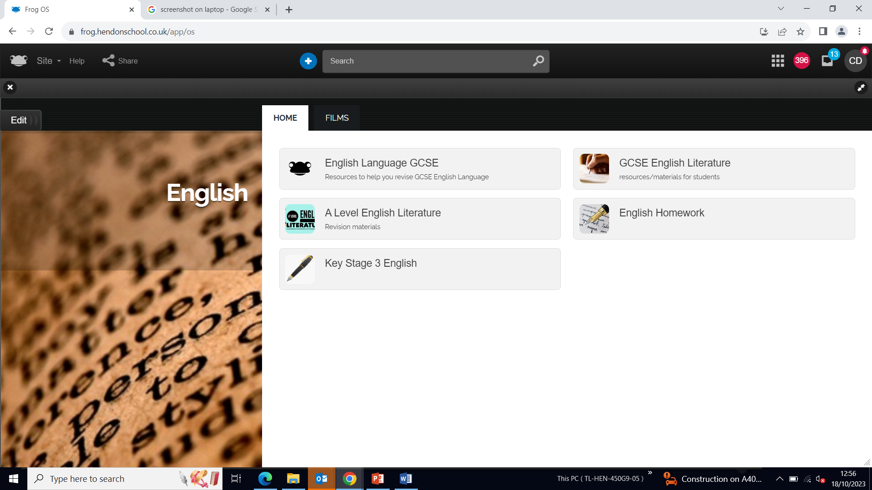
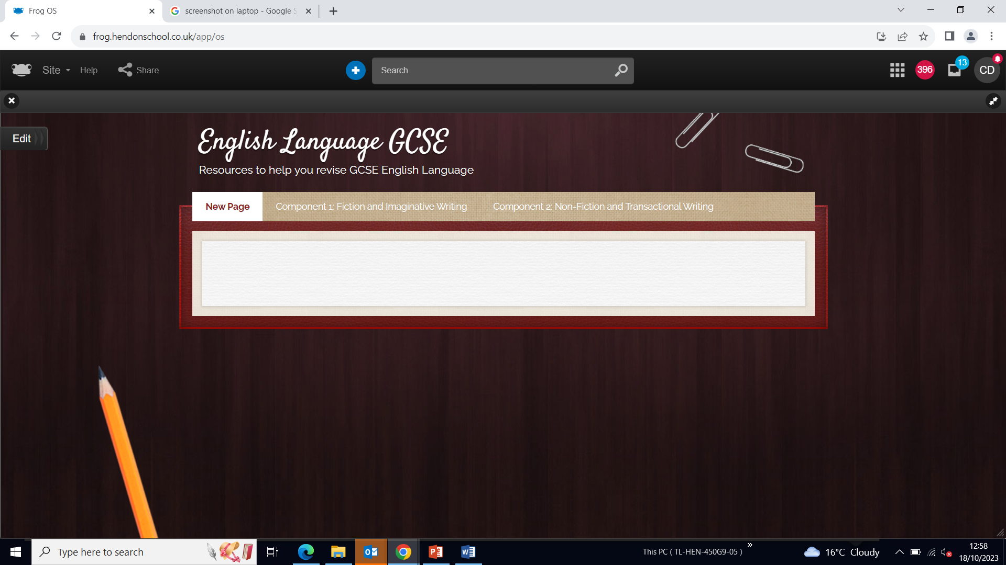
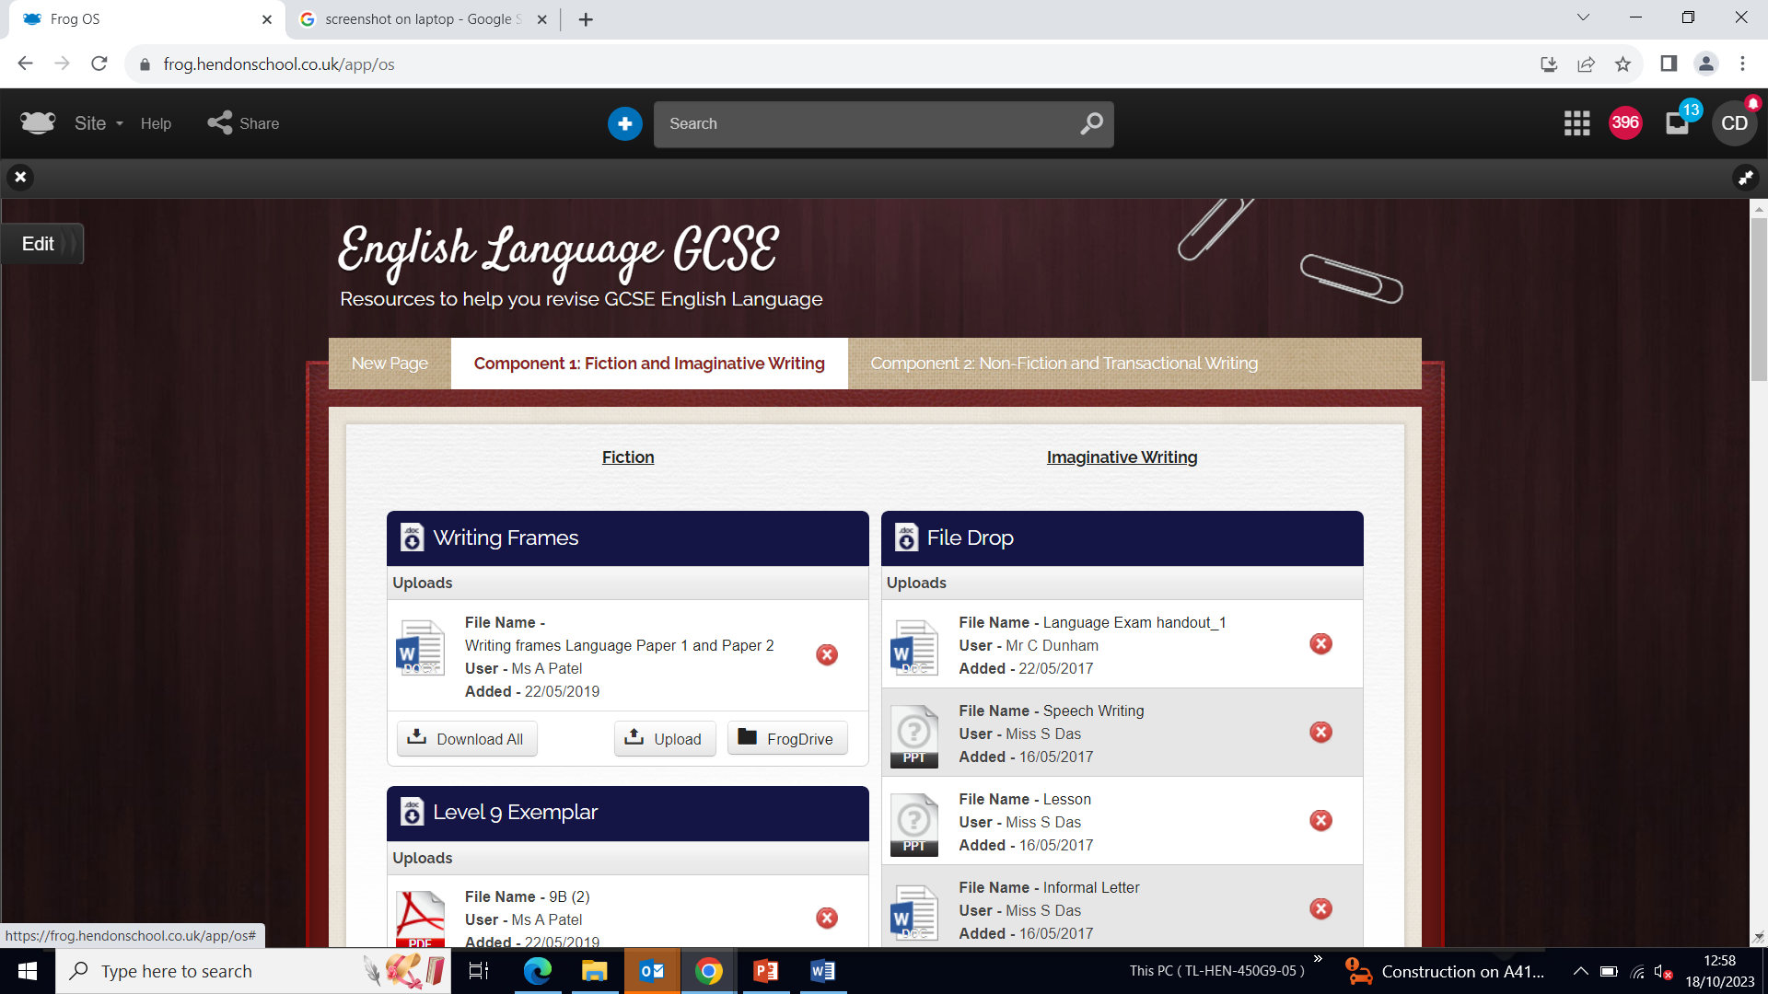
Helping Your Child to Revise

Slide 12
Maths – Course Outline
Exam Board – Edexcel
Mock Exams in December and February
3 Papers, 90 minutes each, 80 marks each

Slide 13
Maths - Resources
Sparx Maths
Active Learn
Maths Genie
Maths Teacher
Homework Club

Slide 14
Maths – How to support you child
Ensure Homework is completed
100% attendance to Maths lessons
Check up on them
Revision timetable
Time off

Slide 15
Maths – Final Word
If the only Maths work you do is in class, this is not enough to achieve your potential. You have to work outside of lessons.
Revise
Revise
Revise

Slide 16
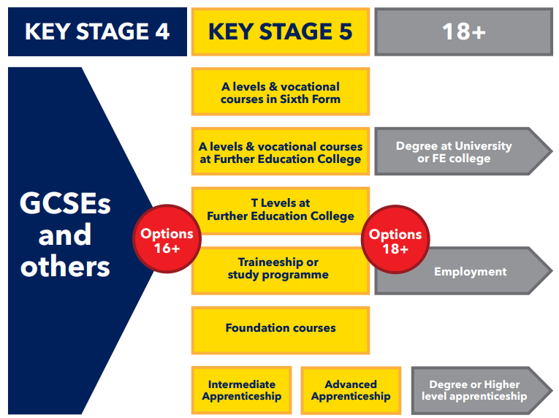
Next steps
The law states that all young people must continue to do some kind of education or training until they are 18. There are lots of different options available to students.

Slide 17
The law states that all young people must continue to do some kind of education or training until they are 18. There are lots of different options available to students.
Next steps

Slide 18
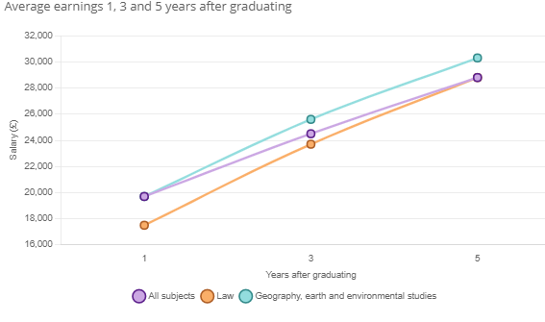
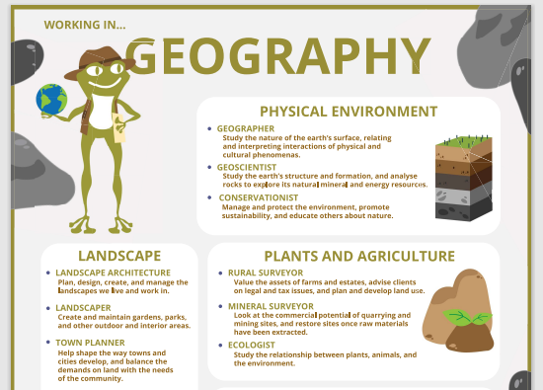
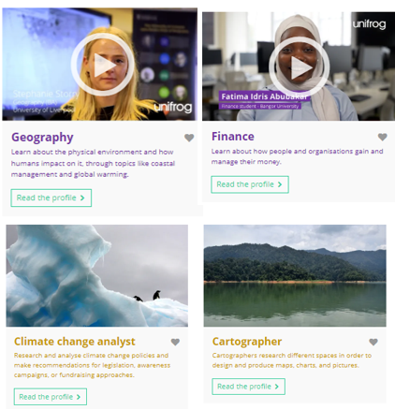
Careers destination platform
“Geographers are among the most employable university graduates. Find out more about choosing geography at GCSE and A Level, continuing to study geography at university, and the career paths that geography opens up for you.”

Slide 19
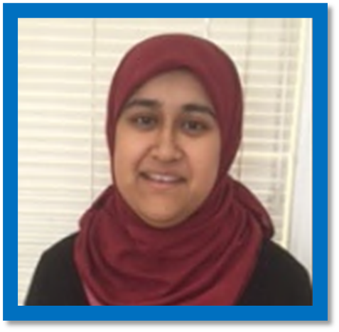
Access to Unifrog
Individual careers guidance meeting this year
Optional group careers session e.g. aspiring lawyers or those planning on applying for an apprenticeship
Assemblies and mentoring sessions about different options
List of all college/ school open evenings shared with students
Optional lunchtime workshops with a range of speakers
Lunchtime drop-in sessions with Mrs Mohammad
Mrs Mohammed our Careers advisor
Contact the team:
Careers@hendonschool.co.uk

Slide 20
Director of Key Stage Four
Ms. Kruczyk

Slide 21
Sixth Form Open Evening
5-7pm
14th November 2024

Slide 22
Refreshments in the Canteen

