Slide 1
Celebrating International Women’s Day & Careers Week

Slide 2
Physical Education
In PE we celebrate these two occasions by welcoming an
Olympic Athlete to work with all
year 7 students.

Slide 3
Hope Gordon
Greatest Achievement
Competing in the Beijing Winter Olympics
Greatest Challenge
Perception of her as a young person with a disability
Future Goals
Paris 2024 Olympics

Slide 4
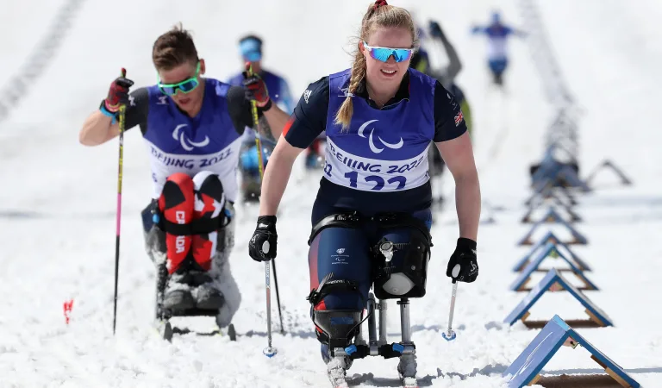
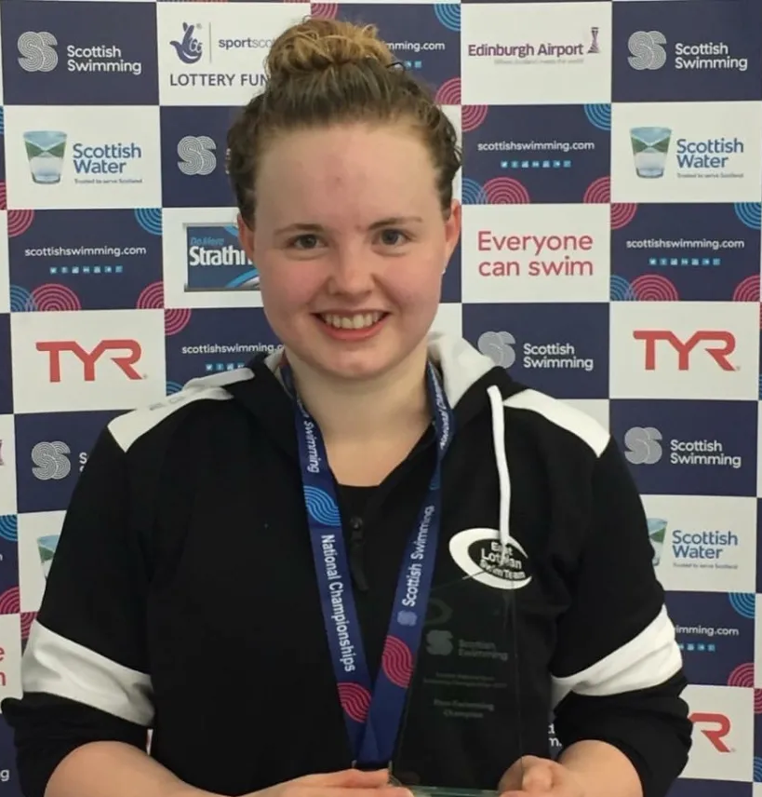
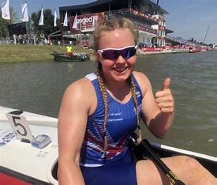
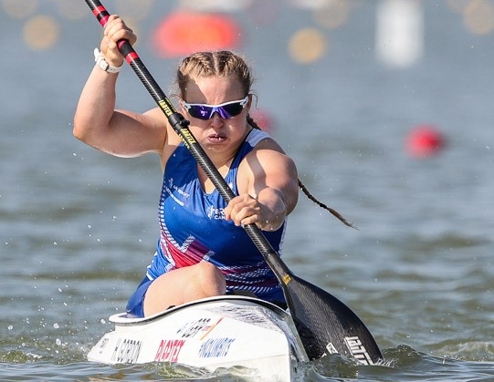
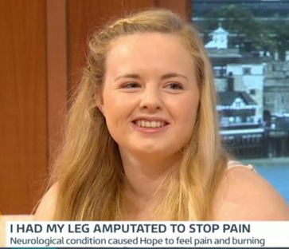

Slide 5
Why do we do this each year?
To inspire you to stay active
To educate, enable and empower you to be the champions of tomorrow
To support unsponsored athletes in the UK by raising money to support their training and reducing some of the financial stress

Slide 6
What happens when the athlete visits?
The athlete will be coming to Hendon on Monday March 6th
Every student in year 7 will take part in a ‘Train like an athlete fitness session’ with the Olympic Athlete
The athlete will lead an assembly to all students sharing their journey
A small presentation and photo opportunity will take place for students that raised the most

Slide 7
What do we need from you?
To help support the athletes become the best they can we want to take away some of the financial stress. Athletes have a 35+ hour training week which leaves them little time for work. Yet training, medical, travel and registration fees are expensive. We, at Hendon, want to support Hope on her journey to the 2024 Paris Olympic Games.
We are therefore setting each student in year 7 the target of raising £3. Each student will receive a sponsorship form for you to take home. Please ask family and friends to sponsor your fitness session and help Hope in her Olympic journey. Students that raise

Slide 8
Fundraising Targets
£3 minimum fundraising target
£5-£15- A6 Postcard of Hope
£15-£34.99- A4 Autographed photo with Biography
£35 or more- Signed instant photo of yourself with Hope Gordon

Slide 9
Sponsorship
You will all receive a sponsorship form from your form tutor today. Please take this home and ask as many family & friends as you can. At a minimum, all you need to do is find at least 6 people to sponsor you 50p
Sponsors can be collected in cash with the form and given not the PE department after half term OR you can also use the QR code on the form and payments can be made online.

